Slide 1
Rest API using ASP.NET core
- https://www.youtube.com/watch?v=fmvcAzHpsk8

Slide 2
Things Covered:
HTTP
CRUD Optns
http verbs: GET(Read), POST(Write/Create), PUT & PATCH(Update), DELETE(delete)
Diff btwn PUT and PATCH:
PUT update replaces the entire entity with the PUT payload. Therefore, while using PUT, the payload requires entity’s all parameters along with the parameter that needs to be modified.
PATCH – patch updates the only parameter in the entity that needs update while ignores/leaves the other parameter in the entity. In Patch request, the data which needs modification alone is sent.
Repository Pattern
Repository Pattern is an abstraction of the Data Access Layer. It hides the details of how exactly the data is saved or retrieved from the underlying data source. The details of how the data is stored and retrieved is in the respective repository. For example, you may have a repository that stores and retrieves data from an in-memory collection. You may have another repository that stores and retrieves data from a database like SQL Server. Yet another repository that stores and retrieves data from an XML file.
Implementation:
Create an (Repository Pattern) Interface and specify the operations that an application requires inorder to talk with the underlying data(XML, SQL, JSON etc).

Slide 3
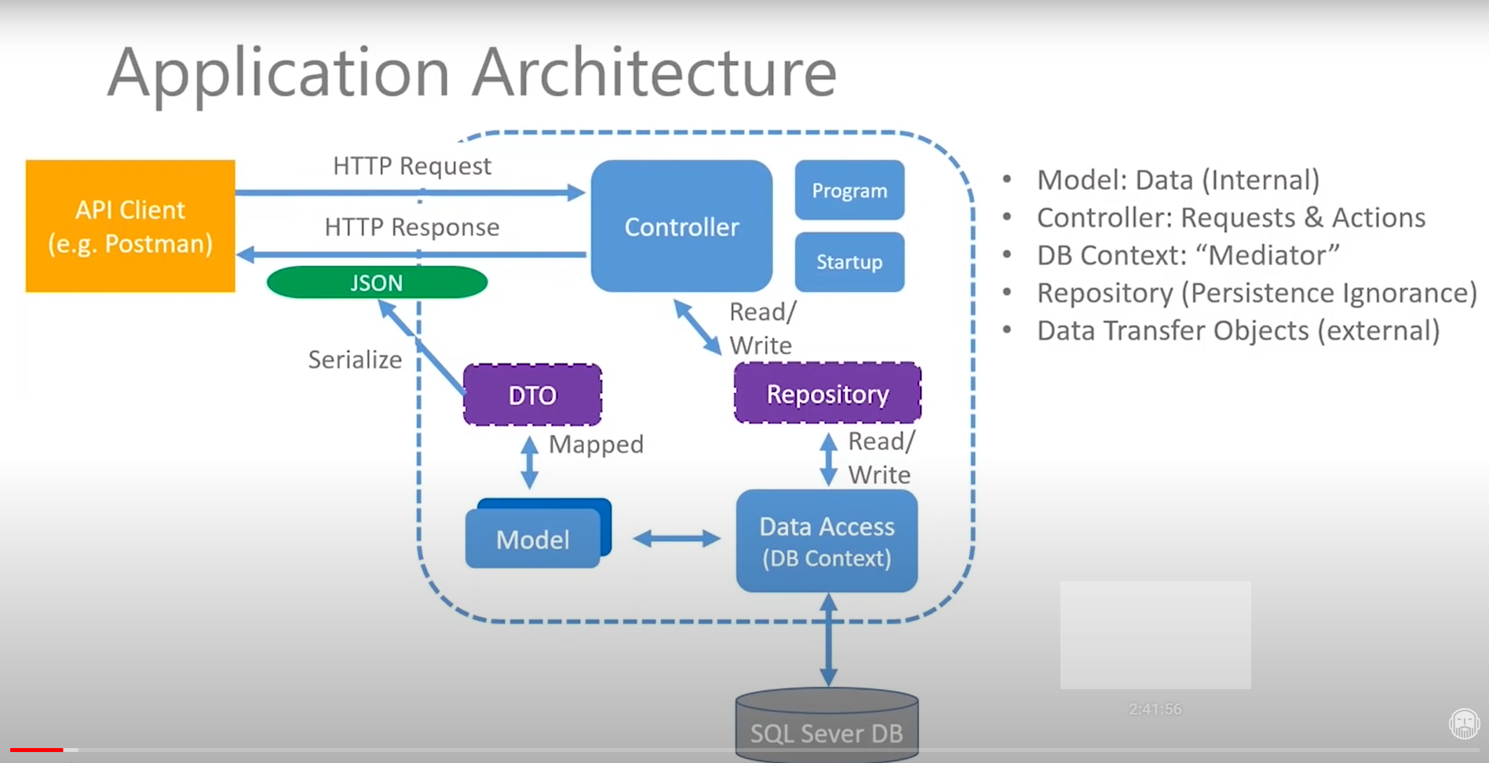

Slide 4
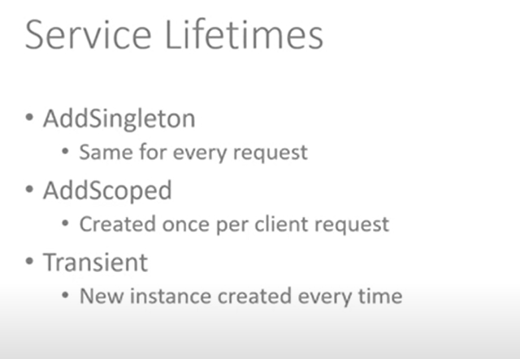
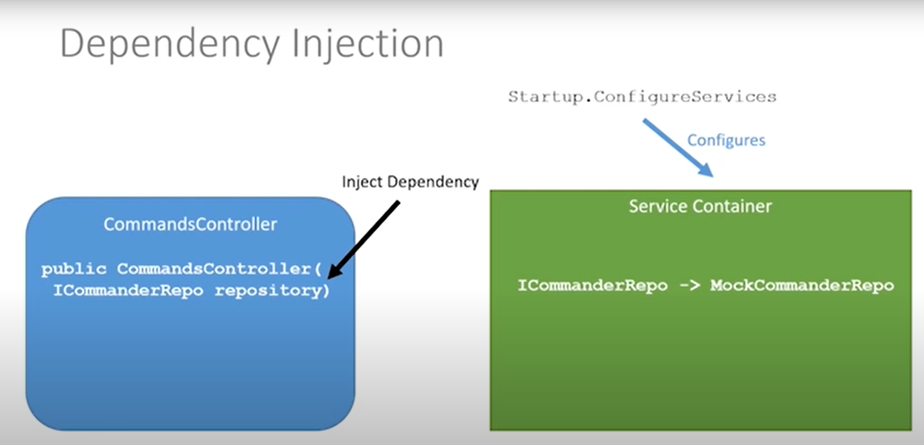
Service Container
- Configures service.
Responsible for providing instance of configured services when referenced via its interface.
Based on how the service life time is configured, either same object or new instance object is returned.
Dependency injection : service is injected by the service container
Service

Slide 5
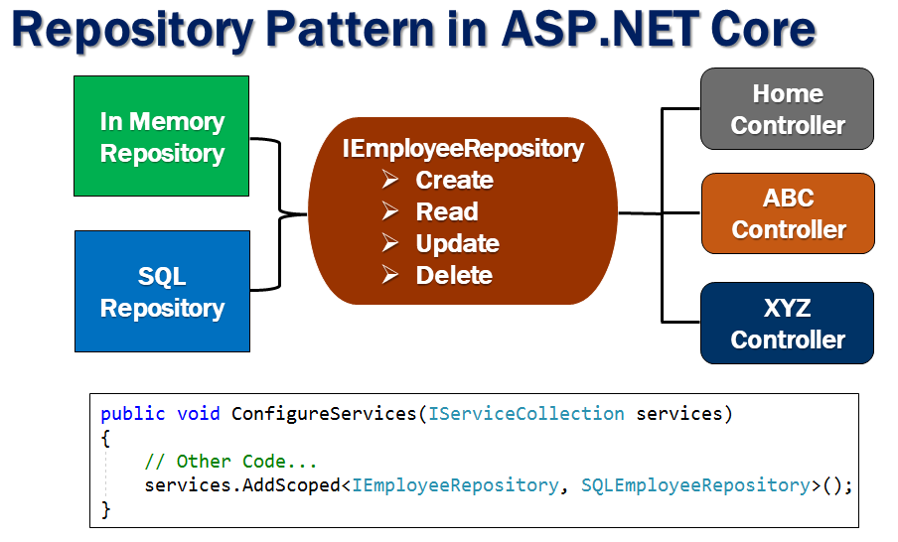

Slide 6
Entity Framework:
Packages Requied:
EntityFrameworkCore
EntityFrameworkCore.Design
EntityFrameworkCore.SqlServer
dotnet ef => ef : entity framework command line tool for dotnet.
dotnet ef [database | dbContext | migration]
SQL Server:
Install Sql Server
Install SQL Management Studio
Create a Sql authenticated login
Add connection string to the app: Server=CHE-LT-I45247A – host name; InitialCatalog = Database name
"myCmdServerConn":"Server=CHE-LT-I45247A;Initial Catalog=myCmdsDb; User ID=myCmdDb;Password=Administrator123!;"

Slide 7
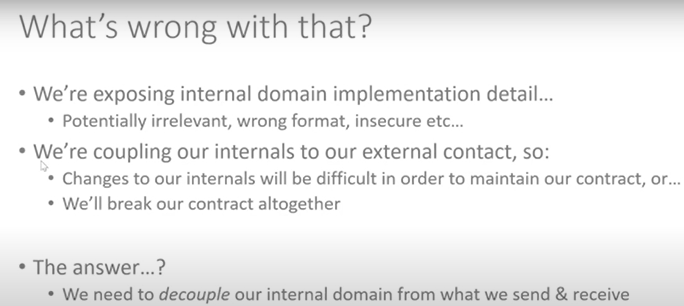
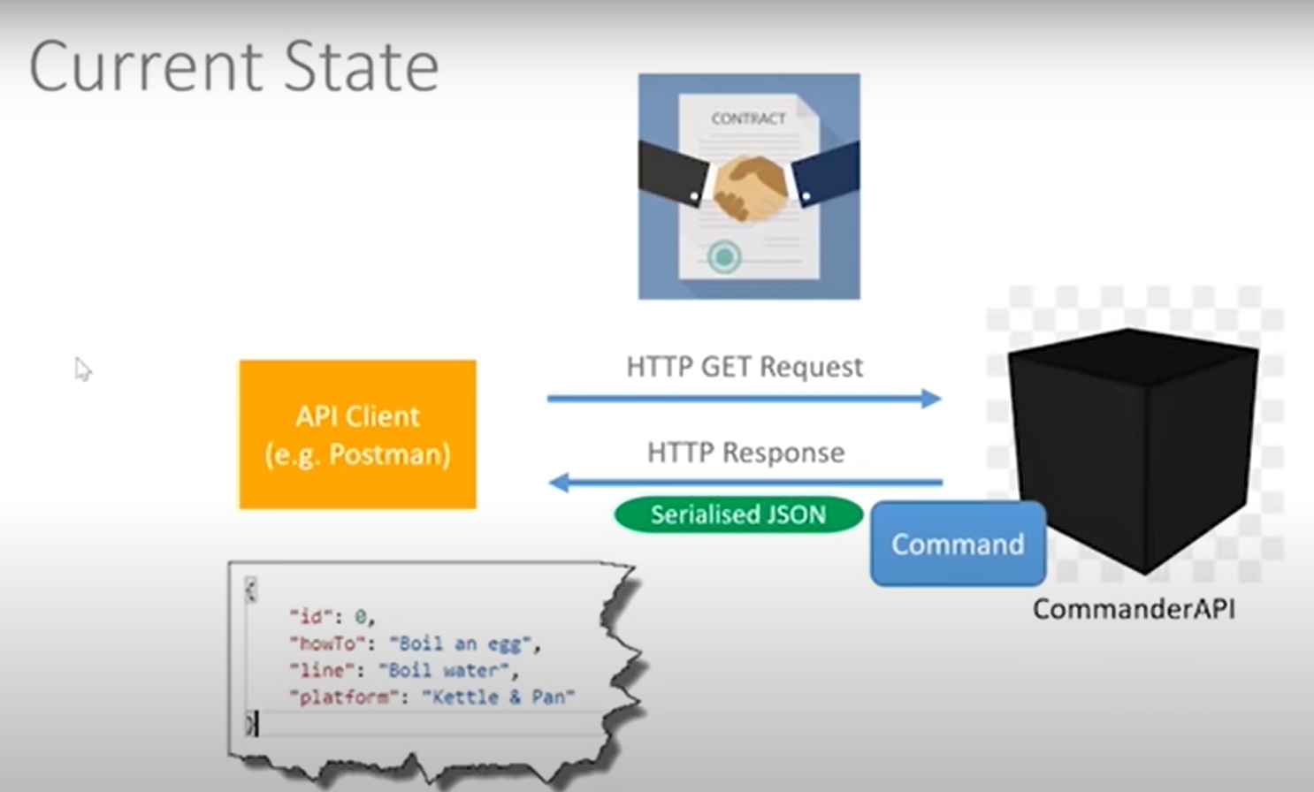
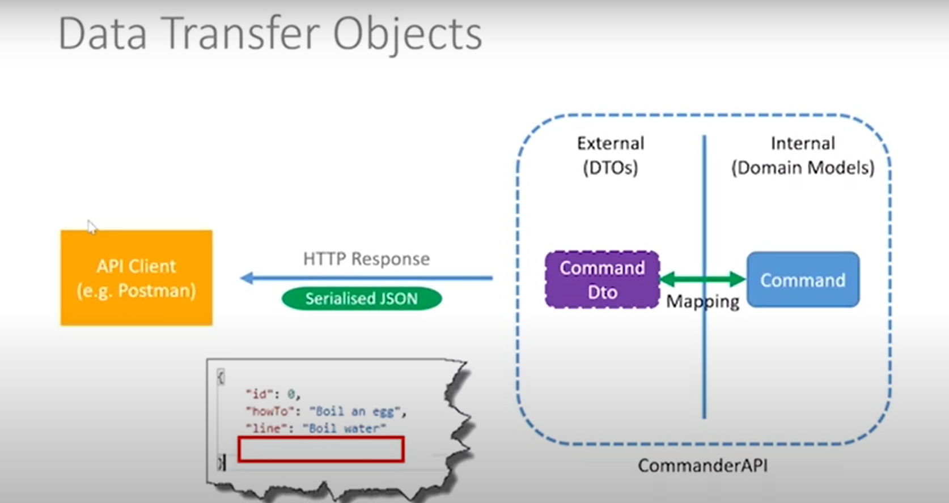
DTO – What and Why
Solution - DTO
DTO can skip Platform which is not required to the customer..

Slide 8
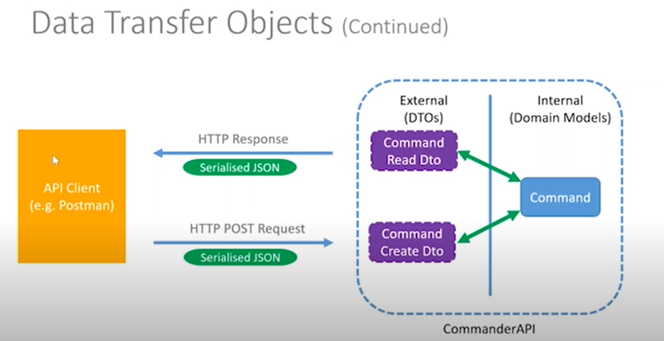

Slide 9
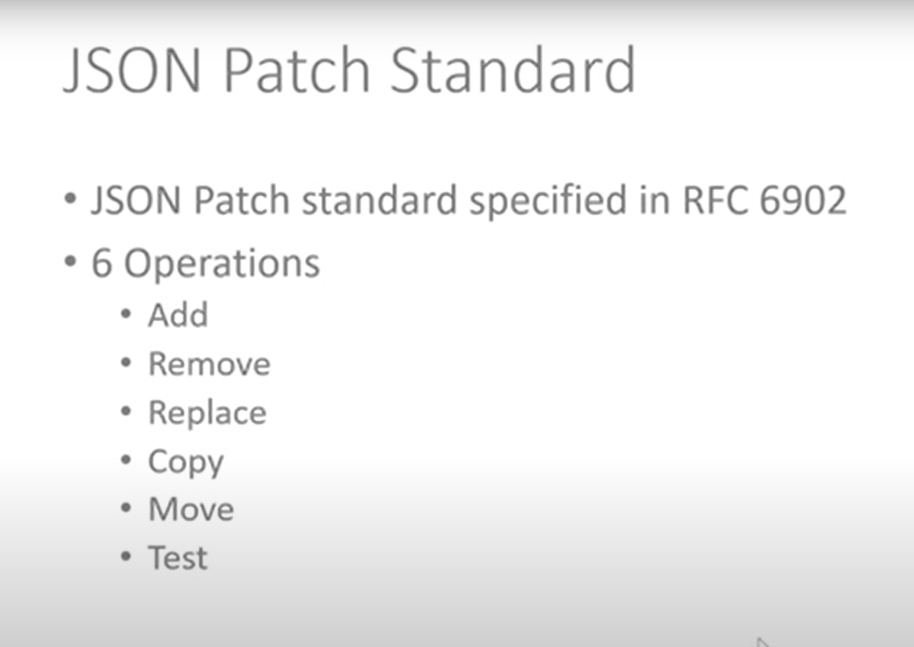
1) How a controller deals with data?
Controller gets the data it deals from repository.
Repo(repository interface) can be for all resources. i.e, A Repo can return commands as well any other data the underlying data base supports.
Controller – can deal with one resource type. i.e, Cmd Controller can do CRUD operation on Cmd.
UserController – can do CRUD Operation on User entity. i.e, CmdController cannot work with user entity on any REST CRUD Optn
2) Why Action/API Endpoint method returns ActionResult not the object directly?
3) Patch is different. Where You pick a entity and can do 6 following operations
-

Slide 10
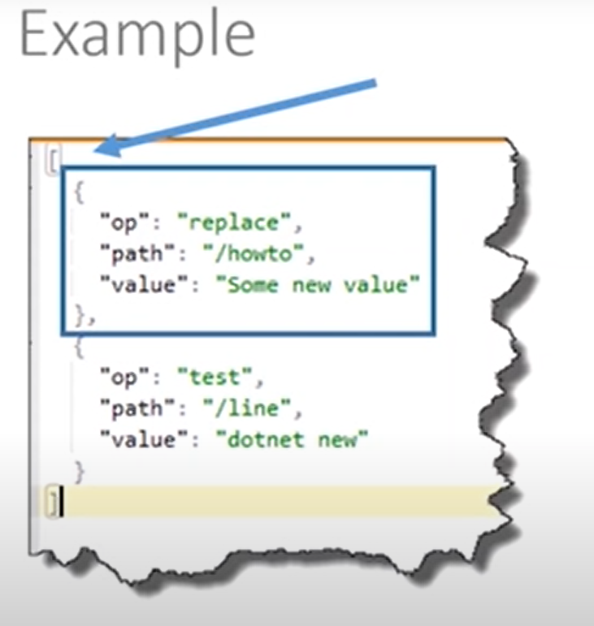
Patch request Body:
An array where each specifies an operation/changes to be performed on the selected single entity.
Patch Package:
Microsoft.AspNetCore.JsonPatch
Microsoft.AspNetCore.Mvc.NewtonSoftJson

Slide 11
Create project vs code Cmds
Cmds:
Dotnet new
Dotnet new webapi –n commandServer (name of project)
Code –r commandServer – open folder in vscode ?

